Slide 1
Welcome to the (ISC)2 Certified Information Systems Security Professional (CISSP) Training Course

Slide 2
Course Agenda
Domain 1: Security and Risk Management
Domain 2: Asset Security
Domain 3: Security Architecture and Engineering
Domain 4: Communication and Network Security
Domain 5: Identity and Access Management (IAM)
Domain 6: Security Assessment and Testing

Slide 3
Course Agenda (continued)
Domain 7: Security Operations
Domain 8: Software Development Security

Slide 4
Security Architecture and Engineering
Domain 3
Notes:
Introduce the participants to the “Cloud Data Security” domain.

Slide 5
^{Domain Objectives}
Implement engineering processes using secure design principles.
Manage engineering processes using secure design principles.
Identify the purpose of security models.
Identify common security models.
Differentiate between security requirements and security controls.
Identify types of controls.
Identify common or inheritable controls.

Slide 6
^{Domain Objectives (continued)}
Select appropriate security controls.
Identify major control frameworks.
Tailor security controls.
Identify security control evaluation criteria.
Identify types of system security capabilities.
Employ integrated security elements.
Identify vulnerabilities and mitigations in client-based systems.
Identify vulnerabilities and mitigations in server-based systems.
Identify vulnerabilities and mitigations in database systems.

Slide 7
^{Domain Objectives (continued)}
Identify vulnerabilities and mitigations in industrial control systems (ICSs).
Identify vulnerabilities and mitigations in cloud-based systems.
Identify vulnerabilities and mitigations in distributed systems.
Identify vulnerabilities and mitigations in Internet of Things (IoT).
Assess and mitigate vulnerabilities in web-based systems.
Assess and mitigate vulnerabilities in mobile systems.
Assess and mitigate vulnerabilities in embedded systems.
Understand key terms associated with cryptography.

Slide 8
^{Domain Objectives (continued)}
Understand how security services such as confidentiality, integrity, authenticity, non-repudiation, and access control are addressed through cryptography.
Understand basic cryptography concepts of symmetric and asymmetric.
Describe hashing algorithms and digital signatures.
Understand the importance of key management.
Understand cryptanalysis methods.
Apply security principles to site and facility design.
Implement and manage physical security controls.

Slide 9
^{Domain Objectives (continued)}
Implement and manage physical controls in wiring closets and intermediate distribution facilities.
Implement and manage physical controls in server rooms and data centers.
Implement and manage physical controls in media storage facilities.
Implement and manage physical controls for evidence storage.
Implement and manage physical controls in restricted areas.
Implement and manage physical controls in work areas.

Slide 10
^{Domain Objectives (continued)}
Implement and manage environmental controls for utilities and power.
Implement and manage controls for heating, ventilation, and air conditioning (HVAC).
Implement and manage environmental controls.
Implement and manage environmental controls for fire prevention, detection, and suppression.

Slide 11
Domain Agenda
Processes Using Secure Design Principles
Select Controls Based upon Systems Security Requirements
Security Capabilities of Information Systems
Vulnerabilities of Security Architectures, Designs, and Solution Elements
Fundamental Concepts of Security Models

Slide 12
Domain Agenda (continued)
Cryptography
Physical Security
Domain Review

Slide 13
Processes Using Secure Design Principles
Module 1
Notes:
Introduce participants to the “Understand Cloud Data Lifecycle” module.

Slide 14
Module Objectives
Implement engineering processes using secure design principles.
Manage engineering processes using secure design principles.
Notes:
Introduce the module topics.

Slide 15
System and Security Engineering Processes
Commonly accepted sources for engineering processes:
International Council on Systems Engineering (INCOSE)
NIST SP800-160 System Security Engineering
ISO/IEC 15026 series-Systems and Software Engineering
ISO/IEC/IEEE 15288 Systems and Software Engineering
Systems and systems security engineering processes have converged across major sources:
NIST and INCOSE recognize system security engineering as a specialty engineering function
Notes:
Introduce the module topics.

Slide 16
Technical Processes
Business and mission analysis process
Stakeholder needs and requirements definition process
System requirements definition process
Architecture definition process
Design definition process
System analysis process
Implementation process
Integration process
Verification process
Validation process
Transition process
Operation process
Maintenance process
Disposal process
Notes:
Introduce the module topics.

Slide 17
Technical Management Processes
Project planning process
Project assessment and control process
Decision management process
Risk management process
Configuration management process
Information management process
Measurement process
Quality assurance process
Notes:
Introduce the module topics.

Slide 18
Enabling Processes
Lifecycle model management process
Infrastructure management process
Portfolio management process
Human resources management process
Quality management process
Knowledge management process
Notes:
Introduce the module topics.

Slide 19
Agreement Processes
Acquisition process
Supply process
Notes:
Introduce the module topics.

Slide 20
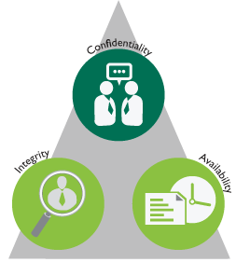
Key Principles of System Security
Confidentiality
Integrity
Availability
Notes:
Introduce the module topics.

Slide 21
Fundamental Concepts of Security Models
Module 2
Notes:
Introduce participants to the “Understand Cloud Data Lifecycle” module.

Slide 22
Module Objectives
Identify the purpose of security models.
Identify common security models.
Notes:
Introduce the module topics.

Slide 23
Security Models
Purpose: Security models define rules of behavior for an information system to enforce policies related to system security but typically involving confidentiality and/or integrity policies of the system.
Notes:
Introduce the module topics.

Slide 24
Security Models Examples
Bell–LaPadula (Confidentiality)
Biba (Integrity)
Brewer and Nash (Confidentiality)
Clark–Wilson (Integrity)
Graham–Denning (Confidentiality/Integrity)
Harrison, Ruzzo, Ullman (Integrity)
Notes:
Introduce the module topics.

Slide 25
Bell–LaPadula (BLP) (Confidentiality)
State machine model
Developed for Department of Defense (DoD)
Used for multilevel security (MLS)
Three properties defined:
No read up (simple security property)
No write down (star property)
Access matrix (discretionary security property)
Notes:
Introduce the module topics.

Slide 26
Biba (Integrity)
State transition model
Focus on integrity vice confidentiality
Opposite direction rules from Bell–LaPadula (BLP)
No Read down (simple integrity property)
No Write up (star integrity property)
Lower level process cannot request higher access (invocation property)
Notes:
Introduce the module topics.

Slide 27
Brewer and Nash (Confidentiality)
Designed to prevent conflict of interest
Information flow control model
Decomposes a company’s information into discrete datasets based on potential conflicts of interest
Defines rules for acceptable access to data objects by a particular subject (e.g., person or process)
Accessing a data object excludes future access to potential conflict of interest objects
Notes:
Introduce the module topics.

Slide 28
Clark–Wilson (Integrity)
Introduces the concept of triples:
Subject
Program
Object
Subjects can only manipulate data objects through the use of a defined program
Set of rules designed to ensure data integrity for all operations
Notes:
Introduce the module topics.

Slide 29
Graham–Denning (Confidentiality/Integrity)
Set of rules for creation, assignment of access rights, and deletion of objects and subjects
Eight rules (create/delete object/subject, assign: read, grant, delete, and transfer access rights)
Often used in distributed systems
Notes:
Introduce the module topics.

Slide 30
Harrison, Ruzzo, Ullman (HRU) (Integrity)
Primarily for protection of access right integrity
Confidentiality is protected by access rights, so HRU does provide secondary confidentiality protection
Extends Graham–Denning model
Defines a set of primitive allowable operations involving subjects and objects
Notes:
Introduce the module topics.

Slide 31
Modern Implementation
Various components of security models are integrated into modern operating systems (OSs).
The access control mechanisms discussed in Domain 5 implement key features of the security model in practical systems.
Security models may not be implemented exactly in modern systems, but they provided the basis for most modern security implementation.
Notes:
Introduce the module topics.

Slide 32
Select Controls Based upon System Security Requirements
Module 3
Notes:
Introduce participants to the “Understand Cloud Data Lifecycle” module.

Slide 33
Module Objectives
Differentiate between security requirements and security controls.
Identify types of controls.
Identify common or inheritable controls.
Select appropriate security controls.
Identify major control frameworks.
Tailor security controls.
Identify security control evaluation criteria.
Notes:
Introduce the module topics.

Slide 34
Security Controls
Safeguards or countermeasures that mitigate risks to confidentiality, integrity, or availability in a system or operating environment.
Controls may impact or modify the behavior of people, process, or technology.
Notes:
Introduce the module topics.

Slide 35
Types of Controls
Control Action Types:
Preventive controls:
Reduce likelihood or impact of an undesirable event occurring
Detective controls:
Identify an undesirable event or collect information about it
Corrective controls:
Reduce or eliminate the impact of an undesirable event that has occurred
Means of Application:
Management:
Policy- or human-driven controls
Operational:
Process-driven controls
Technical
Controls applied to technology
Notes:
Introduce the module topics.

Slide 36
Common/Inheritable Controls
Common or Inheritable controls exist outside of a particular system but provide some confidentiality, integrity, or availability protection to the system
For example, enterprise firewall protections are inherited by systems behind the firewall
May include management, operational, or technical controls
Notes:
Introduce the module topics.

Slide 37
Control Selection
Controls are selected to support the confidentiality, integrity, and availability needs of the system.
Control frameworks are often utilized to select appropriate controls and define controls.
Inheritable controls that support the system are identified.
Notes:
Introduce the module topics.

Slide 38
Control Frameworks
Control frameworks define controls and control elements.
Frameworks allow for standardization of control implementation.
Control frameworks often include evaluation criteria or mechanisms to verify controls are effective.
Notes:
Introduce the module topics.

Slide 39
Example Control Frameworks and Standards
ISO/IEC 27001
International Standard
NIST (SP 800-53)
Required for US government use
COBIT
Focused on business values
ISA/IEC 62443 (ISA 99)
Industrial Automation and Control Systems
Notes:
Introduce the module topics.

Slide 40
Tailoring Controls
Control frameworks and standards are intended to be tailored to specific use-cases.
Adjust control specifications or parameters to meet the needs of a specific system or environment.
“Book” controls must be tailored to provide optimal value.
Important:
Controls are not intended to be checklist items but some organizations treat them as such.
Notes:
Introduce the module topics.

Slide 41
Evaluation Criteria
Each control should include specific evaluation methods and expected results.
Example evaluation methods from NIST:
Test: conduct a direct test of the control (usually used for technical type controls)
Interview: Interview or question staff (usually used for management or operational controls)
Examine: Examine documentation or artifacts for evidence that a control is properly employed (used for all control types)
Controls may be evaluated by multiple methods
Notes:
Introduce the module topics.

Slide 42
Security Capabilities of Information Systems
Module 4
Notes:
Introduce participants to the “Understand Cloud Data Lifecycle” module.

Slide 43
Module Objectives
Identify types of system security capabilities.
Employ integrated security elements.
Notes:
Introduce the module topics.

Slide 44
System Security Capabilities
Access control
Processor states
Memory management
Process isolation
Data hiding
Abstraction layers
Security kernel
Encryption
Code signing
Audit and monitoring
Virtualization/sandbox
Hardware security Modules
File system attributes
Notes:
Introduce the module topics.

Slide 45
Generic Operating System (OS)/Computer Model
Notes:
Introduce the module topics.

Slide 46
Access Control
OS controls access to objects
Rules define allowable behavior
Security monitor or reference monitor enforces allowed behavior
File systems typically support by assigning security attributes to objects/files
Access control models are described in detail within Domain 5
Notes:
Introduce the module topics.

Slide 47
Processor States
Processors typically support at least two states of operation:
User mode
Kernel mode
User mode has limited access to core functions or direct hardware access
Notes:
Introduce the module topics.

Slide 48
Memory Management
Direct application access to system memory is restricted
Modern operating systems randomize memory locations (address space)
Modern operating systems limit memory locations where code can execute
E.g., Data Execution Prevention (DEP) in Windows
Notes:
Introduce the module topics.

Slide 49
Process Isolation
Processes execute in separate memory spaces
Direct exchange between processes is limited
Operating system (OS) manages inter-process exchanges through controlled interfaces
Notes:
Introduce the module topics.

Slide 50
Data Hiding
Typical with multilevel security (MLS) architectures using mandatory access control (MAC)
Data or objects at a higher security level cannot be seen by objects at a lower security level
Associated to the Bell–LaPadula (BLP) security model
Also a coding practice where raw data is hidden from access and can only be obtained from a standardized interface
Notes:
Introduce the module topics.

Slide 51
Abstraction layers
Limits direct access to objects or entities
Defines allowable actions and interactions between layers
Protects against improper behavior or access between layers
Notes:
Introduce the module topics.

Slide 52
Security Kernel
Also known as a reference monitor
“Big Brother” of kernel mode
Monitors and validates access control over system objects (e.g., files, network stack)
Enforcement and validation component of all secure operating systems
Notes:
Introduce the module topics.

Slide 53
Encryption
Encryption can be applied to data at rest (e.g., files on hard drive) or data in transit (e.g., communication channel)
May protect confidentiality and/or integrity of data
Data cannot be read without the proper decryption key
Protects data when OS features (e.g., security kernel) are not active or present
E.g., Windows Bitlocker protects data when the OS is not running and an attempt is made to physically remove and read the computer hard drive
Notes:
Introduce the module topics.

Slide 54
Code Signing and Validation
Cryptographic function
Executable code is digitally signed
OS validates signature before loading code
Unsigned code or code with an invalid signature is prevented from executing
May include OS internal code to prevent replacement of OS components
Notes:
Introduce the module topics.

Slide 55
Audit and Monitoring
System actions are recorded and stored in a protected location
Audit storage protection levels vary by system and must be enabled and validated
Specific actions that are recorded are typically customizable
Audit records MUST be reviewed or monitored to be an effective protection
Monitoring and review may include both automated and manual elements
Audit records are typically transferred off of a system for protection and long term storage
Notes:
Introduce the module topics.

Slide 56
Virtualization/Sandbox
Executing code is “wrapped” in a virtualization or sandbox layer
Code executing within the environment is strictly limited from direct interaction outside the environment
Permissions for system access may be restricted independently for each virtualized or sandboxed instance
May be an OS native function or function provided by third-party software
Notes:
Introduce the module topics.

Slide 57
Hardware Security Modules
Hardware components that provide security services
Trusted Platform Module (TPM)
Most common security module, present in most modern hardware platforms
Provides secure storage and cryptographic functions
Typically used to securely generate and store encryption keys
Keys or stored data cannot be extracted from the module without appropriate permissions
Specialized devices (e.g., cell phone) may contain multiple hardware security modules
Notes:
Introduce the module topics.

Slide 58
File System Attributes
Various file systems may store security attributes or provide security functions
A critical component to employing access control models in most operating systems
File systems may include journaling that can protect data integrity
Notes:
Introduce the module topics.

Slide 59
Host Protection Software
Antivirus
Host-based intrusion prevention (HIPS)
Host firewall
File integrity monitoring (FIM)
Configuration and policy monitor
Notes:
Introduce the module topics.

Slide 60
Vulnerabilities of Security Architectures, Designs, and Solution Elements
Module 5
Notes:
Introduce participants to the “Understand Cloud Data Lifecycle” module.

Slide 61
Module Objectives
Identify vulnerabilities and mitigations in client-based systems.
Identify vulnerabilities and mitigations in server-based systems.
Identify vulnerabilities and mitigations in database systems.
Identify vulnerabilities and mitigations in Industrial Control Systems (ICS).
Identify vulnerabilities and mitigations in cloud-based systems.
Identify vulnerabilities and mitigations in distributed systems.
Identify vulnerabilities and mitigations in Internet of Things (IoT).
Notes:
Introduce the module topics.

Slide 62
Module Objectives (continued)
Assess and mitigate vulnerabilities in web-based systems.
Assess and mitigate vulnerabilities in mobile systems.
Assess and mitigate vulnerabilities in embedded systems.
Notes:
Introduce the module topics.

Slide 63
Vulnerabilities of Security Architectures, Designs, and Solution Elements
This module introduces some common vulnerabilities and mitigation approaches
These are common among most system types
It presents typical vulnerabilities and mitigation approaches for various system types
The vulnerabilities and mitigations are not intended to be comprehensive for each system type
For each system type, consider which common vulnerabilities might exist in the various system components
Notes:
Introduce the module topics.

Slide 64
Top Threat Actions/Mitigations
Top Threat Actions
Hacking
Social engineering
Malware distribution
Phishing
Top Mitigations
Know what you have
Patch and manage what you have
Assess/monitor/log
Educate users
Notes:
Introduce the module topics.

Slide 65
Common System Vulnerabilities
Hardware
Hardware components may fail at any time
Mean time between failure (MTBF) used to calculate expected life
Failure rates higher during initial system operation
Supply chain issues may introduce technical flaws/vulnerabilities or malicious modification
Old hardware may be difficult to repair/replace
Notes:
Introduce the module topics.

Slide 66
Common System Vulnerabilities (continued)
Communications:
Can fail
Can be blocked (denial of service (DoS))
Can be intercepted
Can be counterfeited (replayed)
Can be modified
Characteristics can expose information about the sender/receiver (e.g., address, location, etc.)
Notes:
Introduce the module topics.

Slide 67
Common System Vulnerabilities (continued)
Misuse by user
Can be intentional or accidental
Can degrade or bypass security controls
Increases in likelihood as difficulty to operate increases
E.g., difficult security requirements increase likelihood of intentional misuse to “get the job done”
Notes:
Introduce the module topics.

Slide 68
Common System Vulnerabilities (continued)
Code flaws
Exist in all software products with more than trivial complexity
May be introduced accidentally or intentionally
Typical risk conditions:
Known flaws, patch available, systems not patched, exploit available
Known flaws, patch not available, exploit available
Unknown flaws, exploit available (zero-day attack possible)
Notes:
Introduce the module topics.

Slide 69
Common System Vulnerabilities (continued)
Emanations
Hardware/physical elements may radiate information
Radio frequency
Visible and non-visible spectrum
Can be used to discern system functions
Can be used to locate systems/components
Notes:
Introduce the module topics.

Slide 70
Client-based Systems
Desktops, laptops, thin client terminals, etc.
Typically present in large quantities
Continuous state of adding new and decommissioning old in most organizations
General purpose devices with inconsistent usage patterns across the install base
Notes:
Introduce the module topics.

Slide 71
Client-based System Vulnerabilities
Physically under user control
Susceptible to user misuse (intentional or accidental)
May be lost/stolen
Monitoring may be difficult
100% update may be difficult
Consider:
Notes:
Introduce the module topics.

Slide 72
Client-based System Mitigations
Patch/update*: Continuous action
General network protections: e.g. Network segmentation, firewall devices, network intrusion prevention or detection
Host protections*: Antivirus, host IPS, host firewall, disk encryption
Monitor*: Logs, alerts, track location
Educate users: Anti-phishing campaign, detecting attacks
*Applied to all general purpose computing systems-servers, database, distributed, cloud-based, web-based
Notes:
Introduce the module topics.

Slide 73
Server-based Systems
Application servers, file servers, domain controllers, print servers, network service servers (e.g., DNS, DHCP, etc)
Centrally managed/controlled
Limited access/functionality
Likely to be in a tightly controlled network segment
Notes:
Introduce the module topics.

Slide 74
Server-based System Vulnerabilities
May be exposed to external communication/services
Updates may be delayed due to operational need
May exist for long periods (risk of being outdated)
High-traffic volume makes monitoring more difficult
Consider:
Notes:
Introduce the module topics.

Slide 75
Server-based System Mitigations
Targeted network protections (server specific rules, restricted ports/protocols)
Strong remote access mechanisms
Configuration and change management
Monitor: Logs, alerts—targeted to server functions
Notes:
Introduce the module topics.

Slide 76
Database Systems
Hosted on servers, cloud, distributed, etc.
Inherits platform vulnerabilities
Typically contains large quantities of valuable information
Typically requires high-speed operation with large number of transactions
Notes:
Introduce the module topics.

Slide 77
Database System Vulnerabilities
Inference
Aggregation
Data mining
High-value target
Consider:
Notes:
Introduce the module topics.

Slide 78
Database System Mitigations
Input validation
Robust authentication/access control
Output throttling
Anonymization
Tokenization
Notes:
Introduce the module topics.

Slide 79
Industrial Control Systems (ICSs)
Typically embedded, limited function hardware
Interfaces between logical (computer) space and the physical world
Includes sensors, motors, actuators, valves, gauges, etc.
Notes:
Introduce the module topics.

Slide 80
Industrial Control System Types
Supervisory control and data acquisition (SCADA)
Distributed control systems (DCSs)
Programmable logic controllers (PLCs)
Notes:
Introduce the module topics.

Slide 81
Industrial Control System Vulnerabilities
Limited functionality
Limited protections
Long lifespan (become outdated)
Susceptible to misuse/error
Highly susceptible to denial of service (DoS) attacks
Attacks can produce physical effects
Often unattended in remote locations
Consider:
Notes:
Introduce the module topics.

Slide 82
Industrial Control System Mitigations
Isolated network infrastructure
Robust network connection restrictions and monitoring
Highly segmented network
Protect communication channels
Robust configuration control
Notes:
Introduce the module topics.

Slide 83
Cloud-based Systems
Components hosted by a cloud service provider (CSP)
CSP assumes specific security responsibilities, the remainder stay with the data owner
Typically high reliability, speed, capacities
CSP to data owner relationship is governed by a contract and/or service-level agreements (SLAs)
Notes:
Introduce the module topics.

Slide 84
Cloud-based System Characteristics
On-Demand Self-Service
Broad Network Access
Resource Pooling
Rapid Elasticity
Measured Service
Multi-Tenancy
Notes:
Introduce the module topics.

Slide 85
Cloud-based System Types
Software as a service (SaaS)
Platform as a service (PaaS)
Infrastructure as a service (IaaS)
Network as a service (NaaS)
Notes:
Introduce the module topics.

Slide 86
Cloud-based System Deployment
Private
Exclusive use by a single organization
On or off premises
Community
Provisioned for exclusive use by a community of users
Public
Open use by general public
Hybrid
Combination of two or more deployment models
Notes:
Introduce the module topics.

Slide 87
Cloud-based System Vulnerabilities
Inherently exposed to external communication/access
Misconfiguration a major risk
May exist for long periods (risk of being outdated)
Gap between CSP and data owner security controls
Consider:
Notes:
Introduce the module topics.

Slide 88
Cloud-based System Mitigations
Reputable cloud service provider that supplies security information/testing results
Well trained system administrators
Robust configuration control/change control
File and communication encryption
Well managed identity and access controls
Notes:
Introduce the module topics.

Slide 89
Distributed Systems
Nodes and processors operate independently
Storage and processing spread across multiple components
Nodes “pass messages” to coordinate and communicate
Example: traditional telephone
Switches operate independently
Coordinate to pass calls between them
Notes:
Introduce the module topics.

Slide 90
Distributed System Vulnerabilities
Lack of central control/monitoring
Data elements may be lost if nodes fail
Inconsistent security levels between nodes is possible
Susceptible to communication failures, compromise, or denial of service (DoS)
Consider:
Notes:
Introduce the module topics.

Slide 91
Distributed System Mitigations
Standard security rules for nodes to enter distributed network
Communication control, encryption, and redundancy
Node backup and data sharing between nodes
Notes:
Introduce the module topics.

Slide 92
Internet of Things (IoT) Systems
Generally small form factor, embedded hardware
Limited functionality OS
May interface with the physical world
Pervasive and often connected to general purpose networks
Functions/accessibility may be unclear to owner/user
Notes:
Introduce the module topics.

Slide 93
Internet of Things (IoT) Vulnerabilities
Limited vendor support for updates
Little to no onboard security capability
Poor code management due to rapid development cycles
May contain limited or weak security implementations on standard protocols (e.g., Bluetooth, WiFi)
Consider:
Notes:
Introduce the module topics.

Slide 94
Internet of Things (IoT) Mitigations
Isolated on private networks with controlled access
Products selected for security features and updatability
Product security/penetration testing
Disable unneeded functions
Notes:
Introduce the module topics.

Slide 95
Web-based Systems
Applications or data accessible and manipulated through a web browser or web service
Often connects to a data source (database) that may be on or off platform
Uses standard protocols and interface languages
Connections are typically dynamic
Notes:
Introduce the module topics.

Slide 96
Web-based System Vulnerabilities
Accessibility to network communications/access
Use of obsolete protocols/encryption
Code/configuration errors that expose components or data
Consider:
Notes:
Introduce the module topics.

Slide 97
Web-based System Mitigations
Protect system behind firewalls and access controls
Limit and monitor communication protocols
Scan, evaluate, and assess interfaces and code (HTML, Java, scripts, etc)
Tightly control configuration and change management
Ensure platform is security configured
Notes:
Introduce the module topics.

Slide 98
Mobile Systems
Phones, tablets, wearable devices
Portable, small form factor
Limited functionality
Embedded OS
Typically contains limited amounts of data
Connected (cellular, WiFi, Bluetooth, tethering)
Designed for single user
Notes:
Introduce the module topics.

Slide 99
Mobile Systems (continued)
Laptops, personal computers
Portable, medium form factor
Full featured operating system
Capabilities similar to a desktop
May contain large amounts of data
Multi-user capable
Connected (WiFi, Bluetooth, tethering, possibly cellular)
Notes:
Introduce the module topics.

Slide 100
Mobile Systems (continued)
Are laptops mobile systems?
Opinions may vary, wide gray area depending on the particular capabilities and configuration of a device
Share physical vulnerabilities with other device types
Capable of more onboard controls (e.g., traditional computer host protections, logging, monitoring, access controls)
Mitigation mechanisms are different from other device types
Some tablets cross the line between laptop characteristics and embedded mobile device characteristics
Notes:
Introduce the module topics.

Slide 101
Mobile System Vulnerabilities
Loss or theft
Weak access controls configured
Unencrypted data
Communication interception or eavesdropping
Limited onboard security services and monitoring
Consider:
Notes:
Introduce the module topics.

Slide 102
Mobile System Mitigations
Mobile device management (MDM) installed
Device tracking, wiping, software control, policy enforcement
Activate screen lock and high complexity passcodes or biometrics
Ensure device is encrypted
Tunnel communications through VPN architecture
Limit software/apps installed to trusted packages
Prevent jailbreak or rooting devices
Do not connect to public networks (e.g., coffee shop, hotel)
Notes:
Introduce the module topics.

Slide 103
Mobile System Mitigations (continued)
For laptops:
Apply all traditional computer system protections (e.g., AV, FW, Host IPS, etc.)
Ensure encryption is activated
Ensure strong passwords, biometrics, or two factor authentication on all user accounts
Activate anti-theft function or tracking functions if available
Tunnel mobile communications through VPN
Do not connect to public networks (e.g., coffee shop, hotel)
Notes:
Introduce the module topics.

Slide 104
Embedded Systems
Computing platform with a dedicated function
Limited function/specialized OS
Limited processing power
Long service life in many applications
Includes System on a Chip (SoC) architectures
Typically includes special device categories:
IoT, ICS, mobile devices
Highly diverse in nature
Specialized computing vs general purpose computing
Notes:
Introduce the module topics.

Slide 105
Embedded System Vulnerabilities
Limited function design does not include all full monitoring and security control implementation
Limited access controls
Limited ability to update, vendor support often time limited
Consider:
Notes:
Introduce the module topics.

Slide 106
Embedded System Mitigations
Limit access to devices
Limit communications to devices
Disable unnecessary/unneeded components/features/communications
Isolate on dedicated networks if connected
Monitor external communications with exterior sensors (e.g., network taps, sensors)
Apply vendor updates when available
Notes:
Introduce the module topics.

Slide 107
Activity: Designing Security into an Architecture Scenario
The National Federal Amalgamated Corporation (NFAC) is developing a new customer facing application for amalgamated data. The initial design includes the following elements:
Database servers within the NFAC data center that store customer private and sensitive data elements
Application servers within the NFAC data center that access the database servers and are accessed by NFAC employee workstations
Employee workstations (some desktop, some laptop) are used by NFAC employees to access the Application servers to access, upload, modify, and delete sensitive customer data
Notes:
Introduce the module topics.

Slide 108
Activity: Designing Security into an Architecture Scenario (continued)
Web servers located with a cloud provider that access NFAC databases and applications to deliver data to external customers through a web browser
Mobile applications distributed to customers for installation on Android and Apple devices that provide customer access via a Mobile Application Service hosted by the same cloud provider hosting the web servers
Notes:
Introduce the module topics.

Slide 109
Activity: Designing Security into an Architecture-Instructions
INSTRUCTIONS
Consider the scenario and the vulnerabilities, mitigations, and controls discussed in the preceding modules. Each of the system types listed in the scenario have inherent strengths and weaknesses. For each item, identify potential risks or weakness and one or more controls or mitigation consistent with the access requirements listed in the scenario.
Notes:
Introduce the module topics.

Slide 110
Activity: Designing Security into an Architecture-Instructions (continued)
Example:
Database Servers:
Risk: Database servers contain bulk sensitive data and may be targeted by adversaries.
Control: Database servers will be placed on a protected network segment and network access controls will prevent access to the database server for any connection except from authorized application servers.
Notes:
Introduce the module topics.

Slide 111
Cryptography
Module 6
Notes:
Introduce participants to the “Understand Cloud Data Lifecycle” module.

Slide 112
Module Objectives
Understand key terms associated with cryptography.
Understand how security services such as confidentiality, integrity, authenticity, non-repudiation, and access control are addressed through cryptography.
Understand basic cryptography concepts of symmetric and asymmetric.
Describe hashing algorithms and digital signatures.
Understand the importance of key management.
Understand cryptanalysis methods.
Notes:
Introduce the module topics.

Slide 113
Cryptography Services
Confidentiality
Integrity
Authenticity
Non-repudiation
Access control
Notes:
Introduce the module topics.

Slide 114
Data Protection
Data at Rest
Backup tapes, off-site storage, password files
Data in Transit
Provides secure and confidential methods to transmit data
Allows the verification of the integrity of the message so that any changes to the message itself can be detected
Notes:
Introduce the module topics.

Slide 115
End-to-end Encryption
Generally performed by the end user within an organization
The data is encrypted at the start of the communications channel or before and remains encrypted until it is decrypted at the remote end
Notes:
Introduce the module topics.

Slide 116
Link Encryption
Encrypts all of the data along a communications path
Communications nodes need to decrypt the data to continue routing
Notes:
Introduce the module topics.

Slide 117
Cryptographic Evolution
Cryptographic techniques:
Manual
Mechanical
Electro-mechanical
Electronic
Quantum cryptography
Notes:
Introduce the module topics.

Slide 118
Key Encryption Concepts and Definitions
Plaintext or cleartext
Ciphertext or cryptogram
Cryptosystem
Algorithm
Encryption
Decryption
Key or Cryptovariable
Non-Repudiation
Cryptanalysis
Cryptology
Collision
Key space
Notes:
Introduce the module topics.

Slide 119
Key Encryption Concepts and Definitions (continued)
Initialization vector (IV)
Encoding/decoding
Substitution
Transposition or permutation
Confusion/diffusion Avalanche
Key clustering
Notes:
Introduce the module topics.

Slide 120
Key Encryption Concepts and Definitions (continued)
Synchronous
Each encryption or decryption request is performed immediately
Asynchronous
Encrypt/Decrypt requests are processed in queues
Hash function
Digital signatures
Symmetric
Asymmetric
Digital Certificate
Certificate authority (CA)
Registration authority (RA)
Notes:
Introduce the module topics.

Slide 121
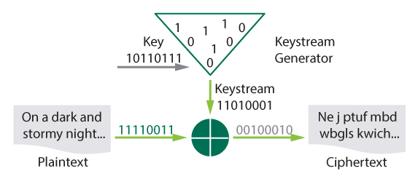
Stream-based Ciphers
A keystream (sequence of bits used as a key) is generated and combined with the plaintext using an exclusive-or (XOR) operation:
Statistically unpredictable and unbiased
Not linearly related to the key
Operates on individual bits or bytes
Functionally complex
Long periods with no repeats
Notes:
Introduce the module topics.

Slide 122
Cryptographic Operation for a Stream-based Cipher
Plaintext is XORed with a seemingly random keystream to generate ciphertext
It is seemingly random because the generation of the keystream is usually controlled by the key
Notes:
Introduce the module topics.

Slide 123
Exclusive-Or (XOR)
Crypto XOR Operation
1
Convert letters into binary values
C = ASCII 67
67 Binary = 01000011
A = ASCII 65
65 Binary = 01000001
2
XOR Values
01000011
01000001
00000010
XOR calculation
Compare two binary values
If both values are same the output is 0
If they are different the output is 1
Transmit = 00000010
Notes:
Introduce the module topics.

Slide 124
Block Ciphers
A block cipher operates on fixed-size blocks of text
The size of the block affects the strength of the cryptographic implementation
As plaintext is fed into the cryptosystem, it is divided into blocks of a preset size
Often a multiple of the ASCII character size — 64, 128, 192 bits, etc.

Slide 125
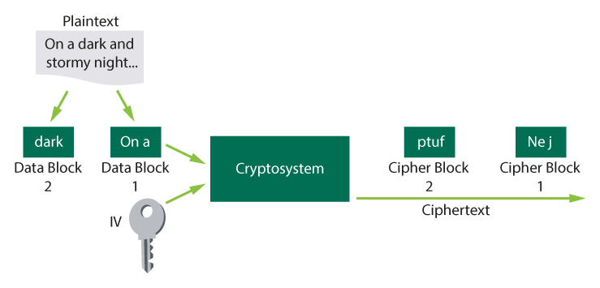
Block Ciphers (continued)
Operate on fixed size blocks of plain text
More suitably implemented in software to execute on general-purpose computer
Overlap when block operated as stream

Slide 126
Key Length
Important aspect of key management to consider when generating and using cryptographic keys
The longer the key, the more keyspace it represents
Notes:
Introduce the module topics.

Slide 127
Block Size
Block ciphers operate on a fixed length string of bits
Typically 64 bits, or multiples of 64 bits
Notes:
Introduce the module topics.

Slide 128
Initialization Vectors (IV) – Why They Are Needed
Encrypting the same plaintext using the same key always produces the same ciphertext
Encrypting the same message with different keys may produce discernable patterns
An IV is a random value added to the plaintext message before encrypting so that each ciphertext will be substantially different
Notes:
Introduce the module topics.

Slide 129
Kerckhoff’s Principle
A cryptosystem should be secure even if everything about the system, except the key, is public knowledge
Notes:
Introduce the module topics.

Slide 130
High Work Factor
Measured in units such as:
Hours of computing time
Cost in dollars of breaking the encryption
If the work factor is sufficiently high, the encryption system is considered to be practically or economically unbreakable
Notes:
Introduce the module topics.

Slide 131
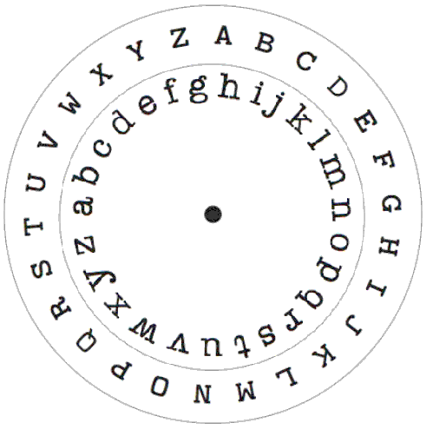
Substitution Ciphers
The process of substituting one letter for another based upon a cryptovariable
Involves shifting positions in the alphabet of a defined number of characters (Caesar cipher and Vigenere cipher)
Involves using a scrambled alphabet to substitute one letter for another (Enigma machine)

Slide 132
Transposition Ciphers
Cryptosystems that use transposition or permutation
Rely on concealing the message through the transposing of or interchanging the order of the letters
T | H | I | S | I
S | A | N | E | X
A | M | P | L | E
O | F | T | R | A
N | S | P | O | S
I | T | I | O | N
Rectangular Substitution Tables

Slide 133
Monoalphabetic and Polyalphabetic Ciphers
Monoalphabetic Cipher
Polyalphabetic Cipher
Developed Circa 15th Century
 | A | B | C | D | E | F | G | H | I | J | K | L | M | N | O | P | Q | R | S | T | U | V | W | X | Y | Z
1 | Z | A | B | C | D | E | F | G | H | I | J | K | L | M | N | O | P | Q | R | S | T | U | V | W | X | Y
2 | Y | Z | A | B | C | D | E | F | G | H | I | J | K | L | M | N | O | P | Q | R | S | T | U | V | W | X
3 | X | Y | Z | A | B | C | D | E | F | G | H | I | J | K | L | M | N | O | P | Q | R | S | T | U | V | W
4 | W | X | Y | Z | A | B | C | D | E | F | G | H | I | J | K | L | M | N | O | P | Q | R | S | T | U | V
…
Encrypt the plaintext ‘FEEDBACK’ using a key of 3241
CCACYYYJ

Slide 134
Running Key Cipher
T | H | I | S
19 | 7 | 8 | 18
O | N | P | E
14 | 13 | 15 | 5
33 | 20 | 23 | 22
-26
7 | 20 | 23 | 22
H | U | X | W
Use the value of plaintext letters and a value of key based on a shared book
Value of Message
‘THIS message …’
+ Value of Key
‘on periodic …’
= Value of Ciphertext
A | B | C | D | E | F | G | H | I | J | K | L | M | N | O | P | Q | R | S | T | U | V | W | X | Y | Z
0 | 1 | 2 | 3 | 4 | 5 | 6 | 7 | 8 | 9 | 10 | 11 | 12 | 13 | 14 | 15 | 16 | 17 | 18 | 19 | 20 | 21 | 22 | 23 | 24 | 25

Slide 135
One-Time Pads
The only cipher system asserted as unbreakable
Both sides have same pad of key values
Truly random key values
Keys are only used once

Slide 136

Steganography
Plaintext hidden/disguised
Prevents a third party from knowing that a secret message exists
Traditionally accomplished in a number of ways:
Physical techniques
Modern steganography
Null ciphers
E1089197693F6C4C26E0033F8C8AF00C
57694B77DCB55C543C6C0BA8E1FF2D17

Slide 137
Null Cipher
Plaintext is mixed with large amounts of non-cipher material
A simple form of steganography
Example:
Closed inspection specific security process integrate security governance really easily and timely
CISSP is great

Slide 138
Null Cipher – Are You Deaf, Father William, William Carroll - 1876
“Are you deaf, Father William!” the young man said,
“Did you hear what I told you just now?
“Excuse me for shouting! Don’t waggle your head
“Like a blundering, sleepy old cow!
“A little maid dwelling in Wallington Town,
“Is my friend, so I beg to remark:
“Do you think she’d be pleased if a book were sent down
“Entitled ‘The Hunt of the Snark?’”
“Pack it up in brown paper!” the old man cried,
“And seal it with olive-and-dove.
“I command you to do it!” he added with pride,
“Nor forget, my good fellow, to send her beside
“Easter Greetings, and give her my love.”
Notes:
Famous poem by William Carrol written in 1876. First letter of each line spells out the name of his lover at the time, Adelaide Paine.

Slide 139
Advantages and Disadvantages of Symmetric Algorithms
Advantages
Disadvantages
Fast
Secure
Confidentiality
Key distribution is very difficult
Not able to provide integrity, authenticity, non-repudiation of origin, access control, and digital signatures
Require both sender and receiver to share the same key
Challenges with secure key distribution
Scalability

Slide 140
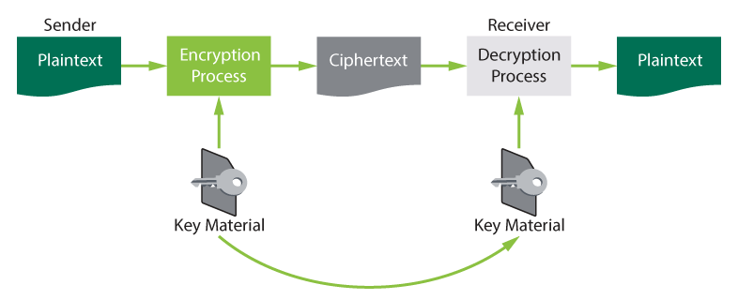
Out-of-Band Key Distribution
Out-of-Band Key Distribution

Slide 141
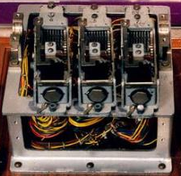
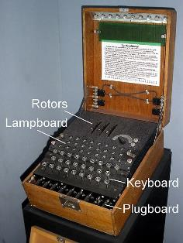
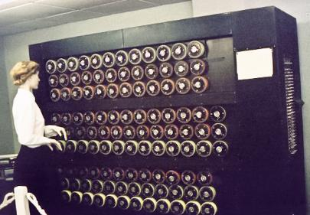
Examples of Symmetric Algorithms
Caesar cipher
System 97 Printing Machine for European Characters
Codename “Purple”
The Spartan scytale
The Enigma machine

Slide 142
Basic Block Cipher Modes
Mode | Usage
Electronic Code Book (ECB) | Very short messages (less than 64 bits in length), such as transmission of a DES key.
Cipher Block Chaining (CBC) | Authentication
Cipher Feedback (CFB) | Authentication
Output Feedback (OFB) | Authentication
Counter (CTR) | Used in high-speed applications such as IPSec and ATM

Slide 143
Basic Block Cipher Modes
Electronic Codebook (ECB) Mode
Cipher Block Chaining (CBC) Mode

Slide 144
Using Symmetric Block Cyphers to Simulate Stream Ciphers
Cipher Feedback (CFB) Mode
Output Feedback (OFB) Mode
Counter (CTR) Mode

Slide 145
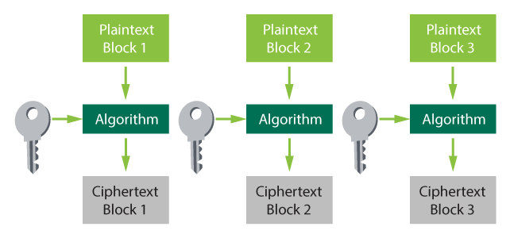
Electronic Codebook (ECB) Mode
Each block of plaintext is encrypted independently using the same key
Only used for small messages – smaller than 64 bits

Slide 146
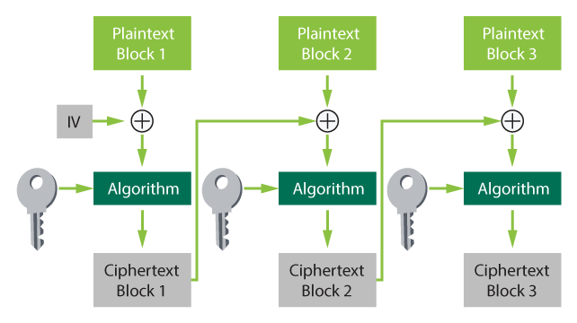
Cipher Block Chaining (CBC) Mode

Slide 147
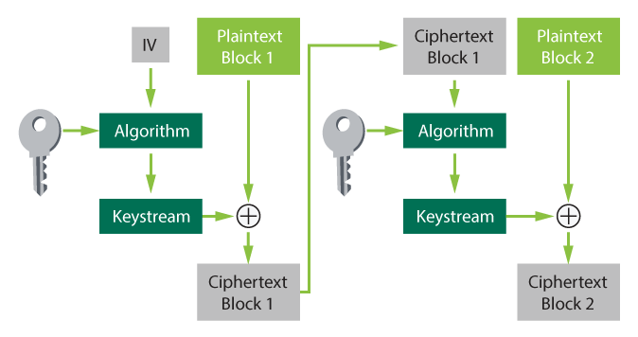
Cipher Feedback (CFB) Mode

Slide 148
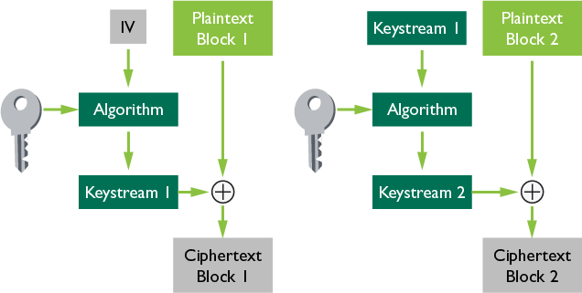
Output Feedback (OFB) Mode

Slide 149
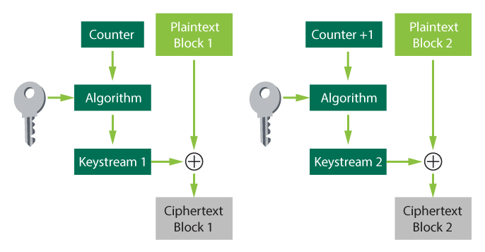
Counter Mode (CTR)

Slide 150
The Data Encryption Standard (DES)
Horst Feistel had developed a family of algorithms that had a core principle of taking the input block of plaintext and dividing it in half
Then, each half was used several times through an exclusive-or operation to alter the other half — providing a type of permutation as well as substitution
A Feistal algorithm became the data encryption algorithm used for DES
DEA Algorithm is Symmetric Block Cipher, 64-bit blocks, 16 rounds, 56-bit effective key length

Slide 151
Double-DES (2DES)
Given today’s technology, DES key is too short to provide adequate protection
One of the first alternatives to create a stronger version of DES was to double the encryption process

Slide 152
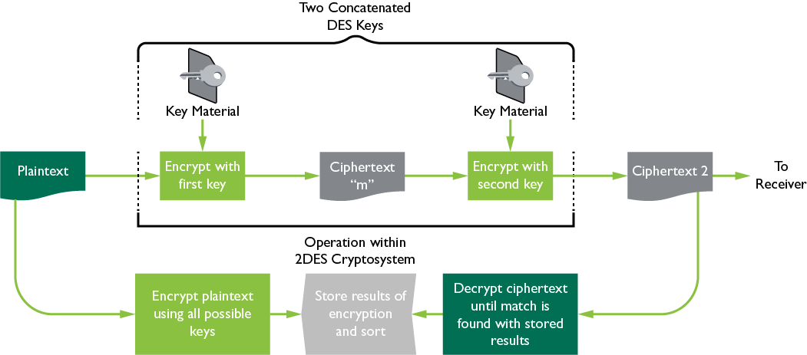
Meet-in-the-Middle Attack on 2DES

Slide 153
Triple DES (3DES)
Triple DES was designed to operate at a relative strength of 2¹¹² using two, or three, different keys to perform the encryption
This effectively rendered a key with a 168-bit strength, as there are always three iterations done with the keys

Slide 154
Counter Mode with Cipher Block Chaining Message Authentication Code Protocol (CCMP)
CCMP is an authentication protocol that forms part of the 802.11i standard for wireless local area networks.

Slide 155
How CCMP Works
AES processing in CCMP must use AES 128-bit key and 128-bit block size
CCMP use of 128-bit keys and a 48-bit IV minimizes vulnerability to replay attacks; the CTR component provides data privacy
The Cipher Block Chaining Message Authentication Code component produces a MIC that provides data origin authentication and data integrity for the packet payload data

Slide 156
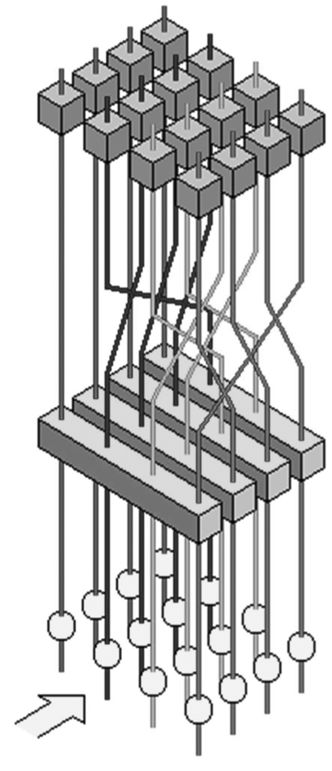
Rijndael
Byte Sub
The Rijndael algorithm can be used with block sizes of 128, 192, or 256 bits
Four major operations:
Shift Row
Substitute bytes
Shift rows
Mix Column
Add
Round
Key
Mix columns
Add round key
Notes:
The winner of the AES competition hosted by NIST. This winner is eventually planned to replace DES as the standard for symmetric key cryptography. Rijndael is the winner, as announced on Oct. 2, 2000, out of approx 30 competitors and later, 5 finalists.
In many respects Rijndael is a relatively simple cipher.
Rijndael has a variable number of rounds. Other then an extra round performed at the end of encipherment with one step omitted, the number of rounds in Rijndael is:
9 if both the block and the key are 128 bits long.
11 if either the block or the key is 192 bits long, and neither of them is longer than that.
13 if either the block or the key is 256 bits long.
The process for enciphering a block of data in Rijndael is to first perform an Add Round Key step (XORing a subkey with the block) by itself, the regular rounds noted above, the final round with the Mix Column step, as described below, omitted.
The Rounds
There are four steps in each round. First is the Byte Sub step, where each byte of the block is replaced by its substitute in an S-box.
Next is the Shift Row step. Considering the block to be made up of bytes 1 to 16, these bytes are arranged in a rectangle, and shifted according to the algorithm. Next comes the Mix Column step. Matrix multiplication is performed: each column, in the arrangement we have seen above, is multiplied by the matrix:
2 3 1 1
1 2 3 1
1 1 2 3
3 1 1 2
The final step is Add Round Key. This simply XORs in the subkey for the current round.

Slide 157
Other Symmetric Algorithms
International Data Encryption Algorithm (IDEA) 128-bit key 64-bit blocks
CAST-128 key length between 40 and 128 bits. 12 and 16 rounds
SAFER uses 64-bit (SAFER-SK64) or 128-bit blocks (SAFER-SK128)
Blowfish uses variable key sizes, from 32 up to 448 bits on 64-bit blocks

Slide 158
Other Symmetric Algorithms (continued)
Twofish can operate with keys of 128, 192, or 256 bits on blocks of 128 bits
RC4 commonly used stream-based cipher
RC5/RC6 key size can vary from 0 to 2,040 bits; the number of rounds 0 to 255

Slide 159
International Data Encryption Algorithm (IDEA)
IDEA uses a 128-bit key and operates on 64-bit blocks
IDEA does eight rounds of transposition and substitution using modular addition and multiplication and bitwise XOR

Slide 160
CAST
CAST-128 can use keys between 40 and 128 bits in length and will do between 12 and 16 rounds of operation, depending on key length

Slide 161
Secure and Fast Encryption Routine (SAFER)
All of the algorithms in SAFER are patent-free
The algorithms work on either 64-bit input blocks (SAFER-SK64) or 128-bit blocks (SAFER-SK128)

Slide 162
Blowfish
Extremely fast cipher and can be implemented in as little as 5K of memory
Operates with variable key sizes, from 32 up to 448 bits on 64-bit input and output blocks

Slide 163
Twofish
Was one of the finalists for the AES
Can operate with keys of 128, 192, or 256 bits on blocks of 128 bits
Performs 16 rounds during the encryption/decryption process

Slide 164
Rivest Cipher 5 (RC5)
Very adaptable product useful for many applications
The key for RC5 can vary from 0 to 2,040 bits
The number of rounds it executes can be adjusted from 0 to 255
The length of the input words can also be chosen from 16-, 32-, and 64-bit lengths
The algorithm operates on two words at a time in a fast and secure manner

Slide 165
Rivest Cipher 4 (RC4)
If RC4 is used with a key length of at least 128 bits, there are currently no practical ways to attack it
The published successful attacks against the use of RC4 in WEP applications are related to problems with the implementation of the algorithm, not the algorithm itself

Slide 166
^{Symmetric Algorithms}
Strength | Name | Key Size
Weak | RC2-40 | 40
 | DES | 56
 | RC5-64/16/7 | 56
Medium | RC5-64/16/10 | 80
 | Skipjack | 80
Strong | RC2-128 | 128
 | RC5-64/12/16 | 128
Strength | Name | Key Size
 | IDEA | 128
 | Blowfish | 128
 | 3DES | 168
Very Strong | RC5-64/12/32 | 256
 | Twofish | 256
 | RC6 | 256
 | Rijndael | 256
Notes:
Some of the common block cipher symmetric algorithms are listed here in a comparison type chart. Note that RC5 is a ‘parameterized’ algorithm – the first parameter refers to the block size in bits, the second parameter refers to the number of iterations during the scrambling, and the last refers to the key length in BYTES (i.e. 7 = 56 bits). This allows it to be used at various strengths. The larger the parameters, the stronger (but slower) the encryption. Obviously, the sender and the receiver must agree upon a given set of parameters.

Slide 167
Advantages and Disadvantages of Symmetric Algorithms
Advantages
Disadvantages
Fast
Secure
Confidentiality
Key distribution is very difficult
Not able to provide integrity, authenticity, non-repudiation of origin, access control, and digital signatures
Require both sender and receiver to share the same key
Challenges with secure key distribution
Scalability

Slide 168
Out-of-Band Key Distribution
Out-of-Band Key Distribution
Cryptovariable

Slide 169
Asymmetric Algorithms
Asymmetric algorithms:
Based on the use of a pair of mathematically related keys
Relies on hard mathematical problems and one-way functions
A process that is much simpler to go in one direction (forward) than to go in the other direction (backward or reverse engineering)
The process to generate the public key (forward) is fairly simple
To learn the private key from knowledge of the public key in computationally infeasible

Slide 170
Asymmetric Algorithms (continued)
Factoring
Discrete Logs
Given P and Q, it is easy to compute P*Q
Given the product N = P*Q, it is not easy to compute P and Q
Pick E (encrypt number)
Compute D so that D*E = 1, MOD (P-1)*(Q-1)
E and N together are the public key, and D and N are the private key
Exponentiation is easy: if you have G and X, it is easy to compute S = G to the power of X
Logarithms are hard: if you have S and G, it is hard to find X such that G to the power of X = S
There are better attacks against discrete logs than brute force
Parameters have to be as large as factoring (512, 1024, 2048 bits)
Notes:
Factoring is splitting an integer into a set of integers that when multiplied together, form the original integer. For example, 35 factors into 5 and 7. Using large prime numbers and multiplying them together is easy, but as far as we know, factoring that product is much more difficult.
The discrete logarithm problem is a mathematical problem using entities called groups. A group is a collection of elements, together with an operation defined on them that is commonly referred to as multiplication or composition and follow certain rules. Assuming the group has a finite number of elements, each element in the group has an order, the minimum number of times it must be multiplied by itself to get back to the identity, which is usually one. The discrete logarithm problem is as follows: given an element g in a finite group G and another element h Î G, find an integer x such that gx = h. For example, the solution to the problem 3x º 13 (mod 17) is 4, because 34 = 81 º 13 (mod 17).
Knapsack algorithms were also used in the past as a third hard math problem for algorithms such as Chor Rivest, Merkle Helman, but mention that KnapSack algorithms are no longer used, as they have been broken.

Slide 171
Using Public Key Cryptography to Send a Confidential Message

Slide 172
Open Message
When a message is encrypted with the private key of a sender, it can be opened or read by anyone who possesses the corresponding public key
When a person needs to send a message and provide proof of origin (non-repudiation), he can do so by encrypting it with his own private key
The recipient then has some guarantee that the message did originate with the sender

Slide 173
Using Public Key Cryptography to Send a Message with Proof of Origin

Slide 174
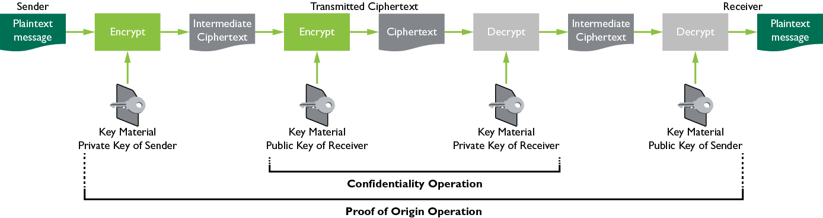
Confidential Messages with Proof of Origin

Slide 175
Rivest-Shamir-Adleman (RSA) Algorithm
RSA is based on the mathematical challenge of factoring the product of two large prime numbers
Three primary attack approaches:
Brute force
Mathematical attacks
Timing attacks

Slide 176
Diffie-Hellman Algorithm
Used to enable two users to exchange or negotiate a secret symmetric key that will be used subsequently for message encryption
Does not provide for message confidentiality, but it is extremely useful for applications such as TLS and IPSEC
Based on discrete logarithms

Slide 177
ElGamal
Included the ability to provide message confidentiality and digital signature services
Based on the same mathematical functions of discrete logs

Slide 178
Elliptic Curve Cryptography (ECC)
The ability to use much shorter keys for ECC implementations provides savings on computational power and bandwidth
This makes ECC especially beneficial for implementation in smart cards, wireless, and other similar application areas
Elliptic curve algorithms provide confidentiality, digital signatures, and message authentication services

Slide 179
Advantages and Disadvantages of Asymmetric Key Algorithms
Advantages
Disadvantages
Possible to send a message across an untrusted medium in a secure manner without the overhead of prior key exchange or key material distribution
Access control
Confidentiality
Integrity
Mathematically intensive and, therefore, becomes extremely slow compared with its symmetric counterpart
Non-repudiation
Authenticity
No scalability problem

Slide 180
Activity: Asymmetric Cryptography
What must the key holder do to allow for the transmission of a confidential message?
Identify one or more advantages of asymmetric cryptography.
Identify one or more disadvantages of asymmetric cryptography.
Describe RSA.

Slide 181
Activity: Asymmetric Cryptography (continued)
ANSWERS
Keep their private key confidential.
It makes it possible to send a message across an untrusted medium in a secure manner without the overhead of prior key exchange or key material distribution.
Extremely slow
RSA is based on the mathematical challenge of factoring the product of two large prime numbers.

Slide 182
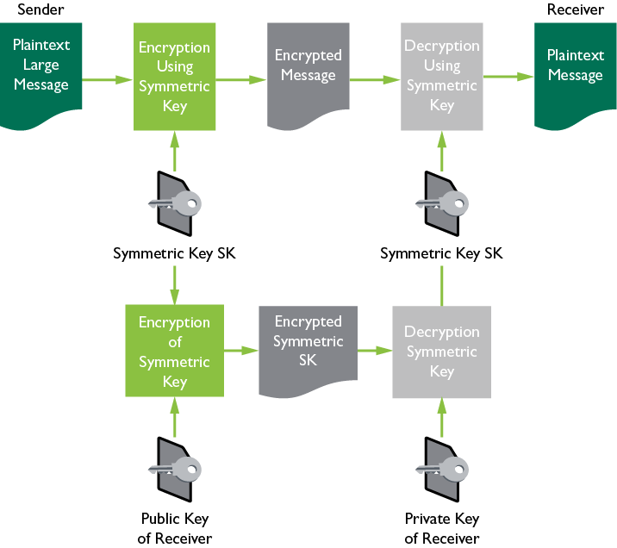
Hybrid Cryptography and Cryptographic Systems

Slide 183
Message Integrity Controls (MICs)
MICs detect alterations (whether intentional or accidental) to a message during transmission
A MIC is a special value that is calculated based on the message contents and added to the message to be sent

Slide 184
Message Integrity Controls (MICs) (continued)
Accomplished through cryptographic functions that perform in several manners, depending on the business needs and level of trust between the parties and systems

Slide 185
Message Integrity Controls (MICs) (continued)
Notes:
This is a diagram illustrating a variety of integrity functions to show where the cryptographic functions fit in. Message Integrity Controls are sometimes called MIC’s
In the next few slides, we will talk in detail about MIC, CBC-MAC, Hash Functions, HMAC, and then Digital Signatures.
In the top row, we show the 3 basic examples of integrity controls (parity, checksum, hash) which can protect against accidental errors (e.g. a bit flipped in a network transmission) but not a determined attacker, who could alter the message, and also alter the integrity control to match the change.
To protect against an intentional integrity attack, we need to use the three choices in the bottom row. We need to protect the message by either encrypting a hash of the message with the private key of an asymmetric key pair (which generates a digital signature), or generating the hash with a secret key (which generates a keyed hash / HMAC), or we can use a special function called a CBC-MAC which doesn’t use a standard hashing function (like MD5 or SHA-1). An example of CBC-MAC is the ANSI X9.9 DES-MAC function which (used by the financial community, also documented as NIST document FIPS-113) computes a DES CBC function over the entire message using a secret key, generating a 64 bit output value. The HMAC (e.g. RFC 2104) uses a standard hash function (such as MD5 or SHA-1) and hashes the message with a secret key, but without a secret key algorithm such as DES. HMACs run much faster than CBC-MAC functions, are believed to be as secure, and support the interchangeable use of different standard hash functions as necessary, so they are increasingly replacing MAC functions for integrity controls (e.g. HMAC is used in SSL and IPSEC).
Remember that a digital signature has a side benefit of providing non-repudiation as well as integrity checking, while a keyed hash does not provide non-repudiation, but it runs much faster and doesn’t require a PKI to be implemented.

Slide 186
Message Digests
A small representation of a larger message
Used to ensure the authentication and integrity of information, not the confidentiality

Slide 187
Message Authentication Code (MAC)
A small block of data that is generated using a secret key and then appended to the message
When the message is received, the recipient can generate his/her own MAC using the secret key and know the message has not changed

Slide 188
Hash Message Authentication Code (HMAC)
Hashed MACing implements a freely available hash algorithm as a component (black box) within the HMAC implementation
This allows ease of the replacement of the hashing module if a new hash function becomes necessary

Slide 189
Hashing
Accepts an input message of any length and generates a fixed-length output

Slide 190
Operation of Hash Functions
Notes:
The purpose of a hash function is to produce a “fingerprint” of a file, message, or other block of data. To be useful for message authentication, a hash function must have the following properties:
• can be applied to a block of data of any size.
• produce a fixed-length output.
• be relatively easy to compute making both hardware & software implementations practical.
• for any given code, it is computationally infeasible to find the message that created it.
• an alternative message hashing to the same value as a given message cannot be found.

Slide 191
Five Key Properties of a Hash Function
Uniformly distributed
Collision resistant
Difficult to invert
Computed on entire message
Deterministic (same input always produces same digest)

Slide 192
MD5 Message Digest Algorithm
The most widely used hashing algorithm and is described in RFC 1321 but no longer considered secure
MD5 generates a 128-bit digest from a message of any length
It processes the message in 512-bit blocks and does four rounds of processing

Slide 193
Secure Hash Algorithm (SHA) and SHA-1
SHA was developed by NIST.
SHA-1 operates on 512-bit blocks and can handle any message up to 2⁶⁴ bits in length.
The output of SHA-1 is 160 bits in length – not considered good practice. Recommended use of SHA-512.
The processing includes four rounds of operations of 20 steps each.

Slide 194
Secure Hash Standard – SHA-3
The new hash algorithm is based on the KECCAK algorithm and will be named SHA-3. It will be described in FIPS 202 (draft as of April 2015) and will augment the hash algorithms currently specified in FIPS 180-4, the Secure Hash Standard.

Slide 195
Other Hash Algorithms
HAVAL – variable length output
RIPEMD-160 – European Standard
The output may be 128, 160, 192, 224, or 256 bits, and the number of rounds may vary from three to five
HAVAL operates 60% faster than MD5 when only three rounds are used and is just as fast as MD5 when it does five rounds of operation

Slide 196
The Birthday Paradox/Birthday Attack
Once there are more than 23 people together, there is a greater than 50% probability that two of them share the same birthday
The likelihood of finding a collision for two messages and their hash values may be a lot easier than may have been believed
It would be very similar to the statistics of finding two people with the same birthday
Rainbow table uses this predictability against hashing systems

Slide 197
Digital Signatures – Non-Repudiation
Provides assurance that the message comes from the person who claims to have sent it
Has not been altered, both parties have a copy of the same document
The sender cannot claim that he/she did not send it
Digital Signature Standard (DSS)
A digital signature is based on a public key (asymmetric) algorithm
Does not provide for confidentiality of the message through encryption and is not used for key exchange

Slide 198
Digital Signatures

Slide 199
Uses of Digital Signatures
A digital certificate is an electronic document that asserts authenticity and data integrity that is tied to a sender
Digital signatures are used to sign emails, ecommerce transactions, software and software patches, and digital certificates
Many governments and courts recognize digital signatures as a verifiable form of authentication

Slide 200
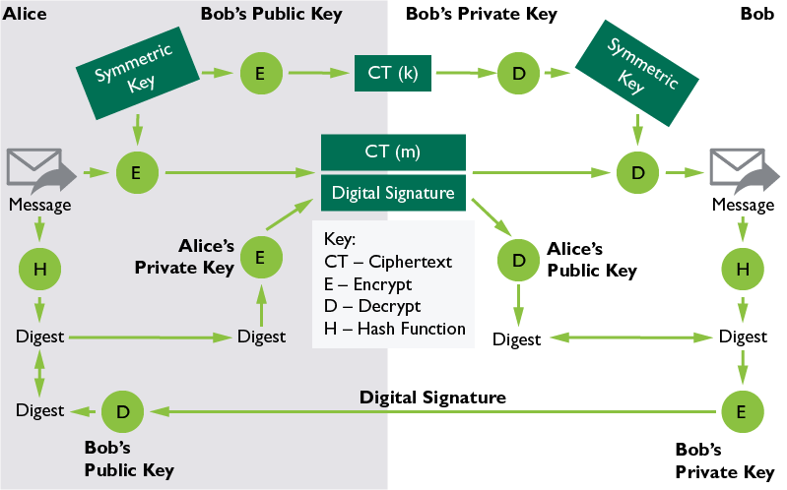
Combine Everything

Slide 201
Applying Cryptography and Key Management

Slide 202
Cryptographic Lifecycle
A cryptographic function is “broken” when one of the following conditions is met:
For a Hashing Function:
For an Encryption System:
Collisions or hashes can be reliably reproduced in an economically feasible fashion without the original source
When an implementation of a hashing function allows a side channel attack
A cipher is decoded without access to the key in an economically feasible fashion
When an implementation of an encryption system allows unauthorized disclosure or alteration of information
Private key has been compromised

Slide 203
Algorithm/Protocol Governance
Cryptography policies, standards, and procedures should minimally address:
Approved cryptographic algorithms and key sizes
Transition plans for weakened or compromised algorithms and keys
Procedures for the use of cryptographic
Key generation, escrow, and secure destruction
Incident reporting

Slide 204
Issues Surrounding Cryptography
As part of risk analysis, it is important to understand how cryptography can be misused so that appropriate security mitigation can be applied
Cryptographic protection is implemented for preventing software and media piracy or corruption of software (digitally signed software and software patches)
Digital rights management systems (DRMS) require a design and governance to protect intellectual property and individual privacy while ensuring an individual’s fair use of the intellectual property

Slide 205
International Export Controls
Most countries regulate the use of cryptographic tools used by their citizens
Most laws that control the use of cryptography are based on key length
Dual use good (can be used for both commercial and military purposes)
This is because key length is one of the most understandable methods of gauging the strength of a cryptosystem

Slide 206
Public Key Infrastructure (PKI)
A set of system, software, and communication protocols required to use, manage, and control public key cryptography
It has core primary purposes:
Publish public keys/certificates
Certify that a key is tied to an individual or entity
Provide verification of the validity of a public key
Provide services such as confidentiality, integrity, authenticity, non-repudiation and access control

Slide 207
Certification/Certificate Authority (CA)
Binds entities to their public keys
“Signs” an entity’s digital certificate to certify that the certificate content accurately represents the certificate owner

Slide 208
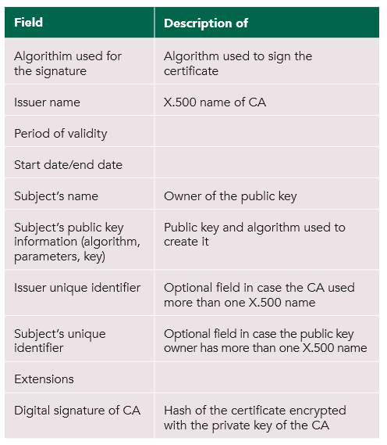
X-509 Certificate

Slide 209
Certificate Revocation
Certificate revocation is required if private key has been compromised
Provides updates on non-valid certificates, in other words, tells certificate holders not to use public key

Slide 210
Key Management and Key Management Practices
Key generation
Key distribution
Key change
Key disposition
Key recovery
Key storage
Notes:
Elements of key management. As the key is the only thing that provides security in cryptography, key management becomes critical in the success of any cryptosystem.

Slide 211
Key Recovery
Dual Control
Two or more people required working in cooperation
Split Knowledge
Specific information known only to one individual that must be combined with knowledge held by another individual
Key Escrow
Storing key with a trusted party

Slide 212
Creation of Keys
Automated key generation
Truly random
Random
Asymmetric key length

Slide 213
Key Wrapping and Key Encrypting Keys (KEKs)
KEKs are used as part of key distribution or key exchange
The process of using a KEK to protect session keys is called key wrapping
Key wrapping uses symmetric ciphers to securely encrypt a plaintext key with associated integrity information and data

Slide 214
Key Distribution
Keys can be distributed in a number of ways
Example:
Out-of-band key exchange
Key wrapping

Slide 215
Key Storage and Destruction
Methods for protecting stored keying material include:
Trusted, tamperproof hardware security modules
Passphrase protected smart cards
Key wrapping the session keys using long-term storage KEKs
Splitting cipher keys and storing in physically separate storage locations
Protecting keys using strong passwords/passphrases, key expiry, and the like
At the end of lifecycle of keys, they must be securely destroyed

Slide 216
Cryptanalysis – Methods of Cryptanalytic Attacks

Slide 217
Activity: Cryptanalytic Attacks
INSTRUCTIONS
As we discuss each of the attacks, complete the table.

Slide 218
Brute Force Attacks
If you assume: Every person on the planet owns 10 computers. There are 7 billion people on the planet. Each of these computers can test 1 billion key combinations per second. On average, you can crack the key after testing 50% of the possibilities. Then the earth's population can crack one encryption key in 77,000,000,000,000,000,000,000,000 years!
Key Size | Possible combinations
1-bit | 2
2-bit | 4
4-bit | 16
8-bit | 256
16-bit | 65536
32-bit | 4.2 x 10⁹
56-bit (DES) | 7.2 x 10¹⁶
64-bit | 1.8 x 10¹⁹
128-bit (AES) | 3.4 x 10³⁸
192-bit (AES) | 6.2 x 10⁵⁷
256-bit (AES) | 1.1 x 10⁷⁷
Key Size | Time to Crack
56-bit | 399 seconds
128-bit | 1.02 x 10¹⁸ years
192-bit | 1.872 x 10³⁷ years
256-bit | 3.31 x 10⁵⁶ years
Supercomputer: No. of combination checks per second = (10.51 x 10¹⁵) / 1000 = 10.51 x 10¹²
https://www.eetimes.com/document.asp?doc_id=1279619
Notes:
Assumptions: Faster supercomputer: 10.51 Pentaflops = 10.51 x 10¹⁵ Flops [Flops = Floating point operations per second]
No. of Flops required per combination check: 1000 (very optimistic but just assume for now)
No. of combination checks per second = (10.51 x 10¹⁵) / 1000 = 10.51 x 10¹²
No. of seconds in one Year = 365 x 24 x 60 x 60 = 31536000
No. of Years to crack AES with 128-bit Key = (3.4 x 10³⁸) / [(10.51 x 10¹²) x 31536000] = (0.323 x 10²⁶)/31536000 = 1.02 x 10¹⁸ = 1 billion billion years

Slide 219
Ciphertext-only Attack
One of the most difficult because the attacker has so little information to start with
All the attacker starts with is some unintelligible data that he suspects may be an important encrypted message
The attack becomes simpler when the attacker is able to gather several pieces of ciphertext and thereby look for trends or statistical data that would help in the attack

Slide 220
Known Plaintext
The attacker has access to the ciphertext and the plaintext versions of the same message
The goal of this type of attack is to find the cryptographic key that was used to encrypt the message
Once the key has been found, the attacker would then be able to decrypt all messages that had been encrypted using that key

Slide 221
Chosen Plaintext
The attacker knows the algorithm used for the encrypting or has access to the machine used to do the encryption and is trying to determine the key
This may happen if a workstation used for encrypting messages is left unattended
The attacker can run chosen pieces of plaintext through the algorithm

Slide 222
Chosen Ciphertext
Similar to the chosen plaintext attack in that the attacker has access to the decryption device or software and is attempting to defeat the cryptographic protection by decrypting chosen pieces of ciphertext to discover the key
Sometimes called the lunchtime attack
An adaptive chosen ciphertext would be the same, except that the attacker can modify the ciphertext prior to putting it through the algorithm
Sometimes called the midnight attack

Slide 223
Linear and Differential Cryptanalysis
Linear cryptanalysis is a known plaintext attack that requires access to large amounts of plaintext and ciphertext pairs encrypted with an unknown key
It focuses on statistical analysis against one round of decryption on large amounts of ciphertext
Differential cryptanalysis is a chosen plaintext attack that seeks to discover a relationship between ciphertexts produced by two related plaintexts
It focuses on statistical analysis of two inputs and two outputs of a cryptographic algorithm

Slide 224
Implementation Attacks
Some of the most common and popular attacks against cryptographic systems due to problems with their implementation ease and reliance on system elements outside of the algorithm such as random number generators.

Slide 225
Replay Attack
Disrupts and damages processing by the attacker by resending repeated files to the host
If there are no checks such as time-stamping, use of one-time tokens or sequence verification codes in the receiving software, the system might process duplicate files

Slide 226
Birthday Attack
The point of the birthday attack is that it is easier to find two messages that hash to the same message digest than to match a specific message and its specific message digest.

Slide 227
Factoring Attack
Because RSA uses the product of large prime numbers to generate the public and private keys, this attack attempts to find the keys through solving the factoring of these numbers.

Slide 228
Attacking the Random Number Generators
This attack was successful against the SSL installed in Netscape several years ago
Because the random number generator was too predictable, it gave the attackers the ability to guess the random numbers
Short Initialization Vectors led to compromise of WEP since the IV was not random enough

Slide 229
Other Cryptographic Attacks
Algebraic
Timing
Power analysis
Frequency analysis
Statistical analysis
Social engineering
Brute force
Dictionary attacks
Rainbow tables

Slide 230
Accessing Temporary Files
Most cryptosystems will use temporary files to perform their calculations
If not deleted and overwritten, they may be compromised and lead an attacker to the message in plaintext

Slide 231
Social Engineering for Key Discovery
Through coercion, bribery, or befriending people in positions of responsibility, spies gain access to systems without having any technical expertise
This is the most common type of attack and usually the most successful

Slide 232
Physical Security
Module 7
Notes:
Introduce participants to the “Understand Cloud Data Lifecycle” module.

Slide 233
Module Objectives
Apply security principles to site and facility design.
Implement and manage physical security controls.
Implement and manage physical controls in wiring closets and intermediate distribution facilities.
Implement and manage physical controls in server rooms and data centers.
Implement and manage physical controls in media storage facilities.
Implement and manage physical controls for evidence storage.
Implement and manage physical controls in restricted areas.
Notes:
Introduce the module topics.

Slide 234
Module Objectives (continued)
Implement and manage physical controls in work areas.
Implement and manage environmental controls for utilities and power.
Implement and manage controls for heating, ventilation, and air conditioning (HVAC).
Implement and manage environmental controls.
Implement and manage environmental controls for fire prevention, detection, and suppression.
Notes:
Introduce the module topics.

Slide 235
Physical Security
Physical security plans and infrastructure are often designed, implemented, and operated by physical security specialists
Physical security infrastructure is typically controlled outside of IT or IT security control
The CISSP MUST understand physical security fundamentals in order to:
Assess the risk reduction value of physical security controls
Communicate physical security needs to physical security managers
Identify risks to Information Security due to physical security weaknesses
Notes:
Introduce the module topics.

Slide 236
Apply Security Principles to Site and Facility Design
Physical design should support confidentiality, integrity, and availability of information systems
Physical design must consider human safety and external factors as well
Notes:
Introduce the module topics.

Slide 237
Physical Design that Supports Confidentiality, Integrity, and Availability (CIA)
Physical design protects information systems from unauthorized access
Provides for auditing or observation of sensitive physical access
Includes identification of subjects in sensitive areas
Ensures robust services (e.g., power, cooling) to information systems
Notes:
Introduce the module topics.

Slide 238
Physical Design that Supports Human Safety
Emergency alarms (audible, visible)
Egress routes
Safety equipment
Emergency power or equipment shutoffs
Equipment lockouts
Notes:
Introduce the module topics.

Slide 239
Site and Facility Design Considerations
Personnel policy and procedure
Personnel screening
Workplace violence prevention
Response protocols and training
Mail screening
Shipping and receiving
Property ID and tracking
Parking and site security
Site and building access control
Video surveillance
Internal access control
Infrastructure protection
Onsite redundancy
Structural protections
Notes:
Introduce the module topics.

Slide 240
Implement and Manage Physical Security
Conduct a physical risk assessment (Domain 1)
Human action, natural disaster, industrial accident, equipment failure, etc.
Develop layered physical protections commensurate with the risk assessment
E.g., Embassy level protections vs a small remote office
Physical risk controls will impact information system design
E.g., weak physical controls may necessitate more complex information system protections to compensate
Physical protections require monitoring and auditing
Notes:
Introduce the module topics.

Slide 241
Perimeter Security Controls
Surrounding Areas:
Roadways
Waterways
Geography
Lines of sight
Consider:
Facility visibility from roads
Potential for vehicle borne threats
Vehicular and pedestrian access point locations
Fencing, perimeter landscaping (natural fence)
Notes:
Introduce the module topics.

Slide 242
Perimeter Security Controls (continued)
Site Entry/Exit points:
Vehicular
Public/customer/visitor
Staff/employee
Delivery/truck
Pedestrian
Consider:
Access controls
Surveillance
Lighting
Intrusion detection
Barriers/traffic control
Notes:
Introduce the module topics.

Slide 243
Perimeter Security Controls (continued)
External Facilities:
Parking structures/lots
Utilities components
Electric transformers/lines
Telecommunications
Landscaping
Consider:
Lighting
Surveillance
Intrusion detection
Lines of sight
Notes:
Introduce the module topics.

Slide 244
Perimeter Security Controls (continued)
Operational Facilities:
Where employees work
Where information technology operates
Consider:
Exterior lighting and surveillance
Building materials
Doors, locks, windows, walls
Entry/exit points and access controls
Staff/employee entrance
Public/customer entrance
Delivery entrance
Sensors/intrusion detection
Notes:
Introduce the module topics.

Slide 245
Perimeter Security Controls—Typical Control Types
Lighting
Bright enough to cover target areas
Limits shadow areas
Sufficient for operation of cameras, must be coordinated with camera plan
Surveillance/camera
Narrow focus for critical areas
Wide focus for large areas
IR/low light in unlit areas
Monitored and/or recorded
Dummy cameras
Notes:
Introduce the module topics.

Slide 246
Perimeter Security Controls—Typical Control Types (continued)
Intrusion detection
Cut/break sensors
Sound/audio sensors
Motion sensors
Barriers
Fixed barriers to prevent ramming
Fixed barriers to slow speeds
Deployable barriers to block access ways
Fencing/security landscaping
Slows and deters
Should not impede monitoring
Notes:
Introduce the module topics.

Slide 247
Perimeter Security Controls—Typical Control Types (continued)
Building material security examples:
High-security glass
Steel/composite doors
Steel telecommunications conduit
Secure walls
True floor to ceiling walls (wall continues above drop ceiling)
Anchored framing material
Solid walls/in-wall barriers
Lock security examples:
Available in varying grades
Physical key locks
Mechanical combination locks
Electronic combination locks
Biometric locks
Magnetic locks
Magnetic strip card locks
Proximity card locks
Multifactor locks (e.g., card + pin)
Notes:
Introduce the module topics.

Slide 248
Internal Security Controls
Controls for human safety
Visible and audible alarms, fire suppression, response plans/training, emergency shutoffs
Controls to manage access
Door locks (e.g., magnetic, card key, mechanical key, combination lock)
Access point security (e.g., mantraps, limited ingress, alarmed emergency egress)
Multifactor access (e.g., key card + pin for room entry)
Internal monitoring
Physical access control system/monitor (e.g., records key card use)
Video surveillance/cameras
RF monitoring
Notes:
Introduce the module topics.

Slide 249
Implement Site and Facility Security Controls
Wiring closets/intermediate distribution facilities
Server rooms/data centers
Media storage facilities
Evidence storage
Restricted area security
Utilities
Heating, ventilation, and air conditioning (HVAC)
Fire prevention, detection, and suppression
Environmental issues
Notes:
Introduce the module topics.

Slide 250
Wiring Closets/Intermediate Distribution Facilities—Components
Entrance facility
External communications enter facility
Phone, network, special connections
May house ISP/provider equipment
Equipment room
Primary communication hub for facility
Houses wiring/switch components
May be combined with entrance facility
Backbone distribution
Connects entrance facility, equipment room, and telecommunication room(s)
Notes:
Introduce the module topics.

Slide 251
Wiring Closets/Intermediate Distribution Facilities—Components (continued)
Telecommunications room (wiring closet)
Serves a particular area of a facility
Floor, section, wing, etc.
Terminates local wiring into patch panels
Backbone distribution is broken out to individual connections (e.g., switch)
Horizontal distribution system
Cables, patch panels, jumpers, cable
Notes:
Introduce the module topics.

Slide 252
Wiring Closets/Intermediate Distribution Facilities—Protections
Security Protections
Rooms must be secured against unauthorized access
Access to rooms should be monitored/recorded
Secondary locks on equipment/racks
Rooms may share space with non-IT equipment and require access by non-IT staff
Conduit or tamper protections for wiring
Environmental Protections
Protection from lightning/surge
Backup power/UPS
Heating/cooling/air flow
Critical in enclosed spaces
Appropriate fire detection/suppression
Emergency shutoffs for high-power connections
May not be necessary in all closets
Notes:
Introduce the module topics.

Slide 253
Server Rooms/Data Centers
Similar security and environmental protections to wiring closets
Access point security and access monitoring is a critical concern
Rack or equipment level locking for shared spaces
Especially in shared spaces
Power/surge/uninterruptible power supply (UPS) equipment is tailored to the operating equipment
Human safety becomes an issue with power levels in most server rooms
Emergency shutoffs and non-conductive hooks/gloves are important for human safety
Appropriate fire detection/suppression must be considered (e.g., sprinkler is inappropriate for electrical fires)
Typically maintained at a higher level of physical security than the rest of the facility
Notes:
Introduce the module topics.

Slide 254
Media Storage Facilities
Media may be stored onsite and offsite from the main facility
Offsite storage should duplicate critical media
Access control is strictly limited and monitored (often limited to archivists)
Temperature/humidity should be consistent with media storage requirements
As media types evolve, this must be continually reassessed
Fire protection at both room and container levels
Notes:
Introduce the module topics.

Slide 255
Evidence Storage
Access strictly limited and monitored
Individual lockers/secure containers for investigations/investigators
Tamper evident seals available for evidence bags/containers
Maintaining chain of custody is critical to prove evidence has not been modified or tampering has not occurred
Evidence protected against damage/theft
Environmental protections should be commensurate with evidence types stored (e.g., paper, digital, media)
Notes:
Introduce the module topics.

Slide 256
Restricted Area Security
Includes secure facilities and classified workspaces
Extremely high access control protections and logging of access
May include audio protections against eavesdropping
May include enhanced visual screening from exterior spaces
May include protection against the detection of electromagnetic emissions from equipment
Notes:
Introduce the module topics.

Slide 257
Utilities
Power
Redundant power input from utilities
Redundant transformers/power delivery
Backup generators
Battery backups
Dual power infrastructure within data centers
Backup sources must be tested/exercised
Backup sources must be sized appropriately and upgraded when load increases
Telecommunications
Multiple service provider inputs
Redundant communication channels/mechanisms
Redundancy on key equipment (eliminate single points of failure)
Water/Sewer
Cooling/human habitation
Risk of leaks/damage to equipment
Supports most building-wide fire suppression plans
Notes:
Introduce the module topics.

Slide 258
Utilities-Safety
Generators, battery backups, and data center power feeds may carry very high electrical loads that are inherently dangerous
Emergency power shutoffs in high-load areas:
Safeguard human life in case of electrocution (big red button)
Safeguard equipment in case of overload (automated shutoff)
Safeguard humans and equipment in emergencies
Flooding/sprinkler activation
High load areas should provide access to nonconductive gloves/equipment and push/pull rods in case of emergency
Notes:
Introduce the module topics.

Slide 259
Heating, Ventilation, and Air Conditioning (HVAC)
High-density equipment requires adequate cooling and airflow
Cooling must be designed match the equipment/space to be cooled
High-capacity rooms (e.g., operations center) must have sufficient airflow for the number of human occupants (CO2 danger)
Air should be filtered for contaminants (natural or intentionally introduced)
Notes:
Introduce the module topics.

Slide 260
Fire Prevention and Detection
Human training and awareness is critical to prevention
Sensors (IR, temperature, smoke) can detect conditions leading up to a fire as well as fire initiation.
Smoke detectors include optical (photoelectric) and physical process (ionization)
Fire detectors include infrared and ultraviolet detectors
Notes:
Introduce the module topics.

Slide 261
Fire Suppression
Buildings should be equipped with one or more types of fire suppression systems than include installed and handheld
Handheld extinguishers are typically chemical agent based with either wet or dry chemicals
Two main types of installed suppression systems: water-based and gas-based
Notes:
Introduce the module topics.

Slide 262
Fire Suppression (continued)
Water-based
Effective for common material fires (e.g., wood, paper, building materials)
Safe for human spaces
Damages equipment
Ineffective for electrical or petroleum fires
Typically cheaper than gas-based
Gas-based
Effective for any fire type
Typically safe for equipment
May be dangerous to humans in enclosed spaces (depending on type)
Costly to install and maintain compared to water-based
Notes:
Introduce the module topics.

Slide 263
Fire Suppression (continued)
Water-based system types:
Wet pipe
Most common, water in pipes, heat activated sprinkler heads
Dry pipe
Pressurized gas in pipes, water released when activated, slight delay, less danger of pipe leaks/freezing
Pre-action
Combines wet and dry pipe actions
Deluge
Pre-action but with open sprinkler heads
Notes:
Introduce the module topics.

Slide 264
Fire Suppression (continued)
Gas system examples:
Hydrofluorocarbon
Halon (older type—mostly gone)
FM-200
Inert gas (e.g., Argon/Nitrogen)
Argonite
Inergen
Aerosol
Aero-K
Notes:
Introduce the module topics.

Slide 265
Environmental Issues
Hurricane
Forest/wildfire
Flooding
Tornado
Earthquake
Mudslide
Notes:
Introduce the module topics.

Slide 266
Domain Review
Module 9
Notes:
Introduce the module topics.

Slide 267
Domain Summary
Application of security engineering and architecture principles is a key element to any system lifecycle.
Security models are used as templates for system security behavior and design.
Security control frameworks are employed to ensure consistent and complete application of security functions across an environment.
Various types of systems have inherent security strengths and weaknesses that must be understood to ensure they are properly employed.
Notes:
Introduce the module topics.

Slide 268
Domain Summary (continued)
The history of cryptography is very long, but over the last 50 years or so, cryptography has become an integral and necessary part of security implementations.
Cryptography can be very effective in providing some key security services such as confidentiality, integrity, authenticity (proof of origin), non-repudiation, and access control.
There are basic fundamental ways to do cryptography, stream and block ciphers.
Symmetric key cryptography is very fast, but has problems related to key distribution and scalability.
Notes:
Introduce the module topics.

Slide 269
Domain Summary (continued)
Asymmetric key cryptography is very slow but solves the problems related to key distribution and scalability.
Hashing, which is defined as one-way encryption, can be very useful in addressing integrity of stored and transmitted information.
Digital signatures can achieve non-repudiation of origin and non-repudiation of delivery.
Key management, and key management techniques are the most important aspects of secure cryptography implementations.
Notes:
Introduce the module topics.

Slide 270
Domain Summary (continued)
There are many cryptanalysis attacks that try and break cryptography systems.
Physical security is an important element to ensure information systems are protected.
Notes:
Introduce the module topics.

Slide 271
Domain Review Questions
Requirements definition, design, implementation, and operation are examples of what type of System and Security Engineering processes?
Technology processes
Acquisition processes
Design processes
Technical processes
Notes:
Introduce the module topics.

Slide 272
Answer
The correct answer is D.
A is incorrect terminology. B and C are specific processes, not types of processes.

Slide 273
Domain Review Questions
One security model includes a set of rules that can dynamically restrict access to information based upon information that a subject has already accessed in order to prevent any potential conflict of interest. This model is known as the:
Biba model
Brewer/Nash model
Graham–Denning model
Harrison, Ruzzo, Ullman model

Slide 274
Answer
The correct answer is B.
A, C, and D are models that describe an information system’s rules for operation, but those rules are applied universally. The Brewer/Nash model is the only model that explicitly addressed conflicts of interest.

Slide 275
Domain Review Questions
Select the best answer. Inheritable or “common” security controls are characterized as:
Controls that are passed down from older systems to new systems through code sharing
Introduces unacceptable risk in most systems
Controls that are never assessed in an operational environment
Controls that are provided from one system to another in an operational environment

Slide 276
Answer
The correct answer is D.
D is the correct definition of the term. A, B, and C are not types of controls. All controls must be assessed whether inherited or not, and while inheritable controls may introduce risk if not operating properly, they do not generally introduce unacceptable risk, which makes D a better answer

Slide 277
Domain Review Questions
Three common types of industrial control systems include:
Supervisory control and data acquisition, distributed control systems, programmable logic controllers
Supervisory control and data anonymization, distributed control systems, programmable logic capability
Supervisory control and data anonymization, distributed chip systems, programmable logic controllers
Supervisory control and data acquisition, distributed chip systems, programmable logic capability

Slide 278
Answer
The correct answer is A.
Items B, C, and D include incorrect terminology.

Slide 279
Domain Review Questions
The four most common types of sprinkler systems are:
Soaking, wet pipe, dry pipe, and pre-action
Wet pipe, dry pipe, deluge, and pre-action
Wet pipe, dry pipe, soaking, and hybrid
Dry pipe, soaking, deluge, and hybrid

Slide 280
Answer
The correct answer is B.
Items A, C, and D each contain at least one incorrect element.

Slide 281
Domain Review Questions
The key used in a cryptographic operation is also called:
Cryptovariable
Cryptosequence
Cryptoform
Cryptolock

Slide 282
Answer
The correct answer is A.
The cryptovariable is the correct definition used by cryptologists to describe the key in a cryptography system.

Slide 283
Domain Review Questions
Most cryptographic algorithms operate either in block mode or:
Cipher mode
Logical mode
Stream mode
Decryption mode

Slide 284
Answer
The correct answer is C.
All ciphers either operate on stream mode, one bit at a time, or block mode, several bits at a time.

Slide 285
Domain Review Questions
Which of the following is NOT one of the primary objectives of cryptography?
Non-repudiation
Authenticity
Data integrity
Authorization

Slide 286
Answer
The correct answer is D.
The five services that cryptography can provide are confidentiality, integrity, authenticity, non-repudiation, and access control. Authorization, therefore, is not a service that cryptography can achieve.

Slide 287
Domain Review Questions
Another name for symmetric key cryptography is?
Shared
Public
Key clustering
Elliptic curve

Slide 288
Answer
The correct answer is A.
Symmetric, which means “the same,” implies that a shared key is required by the sender and the receiver in order to be able to encrypt and decrypt a message or data.

Slide 289
Domain Review Questions
How many keys would need to be managed for an asymmetric key system such as RSA with 500 users (N)?
Nx2
N (N-1)/2
2 to the power of N
N to the power of 2

Slide 290
Answer
The correct answer is A.
Asymmetric key cryptography algorithms require users to have their private and public key pairs, two keys each. For 500 users, each having a key pair, the answer is 1,000, or Nx2.

